Slide 1

TRAC Library System
by: Tan Kang Hong
Har Chun Wai
Lau Jun Dian
Low Jun Yan
Ho Jing Xian

Slide 2
01
Case Study Organisation
Organisation Background
02
System Planning
System Request
Feasibility Study
CONTENTS
03
System Analysis
Context Diagram
Diagram 0 DFD
Diagram 1 DFD
ERD Diagram
04
System Design
Data Input Screen
Complete ERD with Attributes and keys
Code design
Reports

Slide 3
01
Case Study Organisation
-Organisation Background

Slide 4
INTRODUCTION
Tun Rahman Abdul College (TRAC) was founded in 1970 and its first started on a campus in Kuala Lumpur and is now the main campus.
Kuala Lumpur’s TRAC (main campus) is located on 200 acres of land. At the same time, branch schools in Penang, Perak, Johor, and Pahang are specially built.
The courses offered by TRAC include pre-university courses, diploma courses, bachelor's degree courses and postgraduate courses. Now, TRAC has gone from basic and A Level to accounting, finance, business, economics, engineering, built environment, applied sciences, ICT and mass communication, creative arts, social sciences and hotel management.
These courses are implemented by 7 colleges and 1 center to implement exchanges and creativity Faculty of Industry and Social Sciences and Humanities. In addition, there is a graduate research center dedicated to research.
TRAC has won numerous academic awards, among which the most prestigious awards include the 2017 top digital technology colleges selected by the Ministry of Higher Education and the Malaysian Digital Economy Corporation ('MDEC').

Slide 5

Facilities of TRAC
Sport Complex and
Clubhouse
Programs and Certificates
Outdoor Facilities
Academic Facilities
-Integrated Innovation Hub
-Student Career Development Centre (SCDC)
-Library
-Cyber Centre
-Newsroom
-Multimedia labs
-Fashion studios
-Chemistry labs
-Biotechnology labs
-Football field
-Futsal courts
-Handball courts
-Volleyball courts
-Basketball courts
-Jogging track
-Diploma
-Degree
-Master
-Doctor
-Gymnasium
-Dancing room
-Badminton courts
-Indoor basketball court
-Roof top tennis court.
-Olympic-sized swimming pool
-Squash courts
-Snooker table
Accomodation
-On-campus hostel
-Off-campus accommodation

Slide 6
Business Operation
Size of business of operation
TRAC started with a single campus in Kuala Lumpur. Afterwards, five branches campuses were established in Penang, Perak, Johor, Pahang and Sabah.
Suppliers
There are some suppliers such as Apple reseller, Google, Telekom Malaysia and Cisco. Some of the suppliers supply books, furniture and etc.
Customers
TRAC is one of the oldest institutions of higher learning in Malaysia with more than 190000 students.
Competitors in the market
TRAC has competitors such as Sunway University, Taylor University, UCSI University, Monash University and etc.

Slide 7
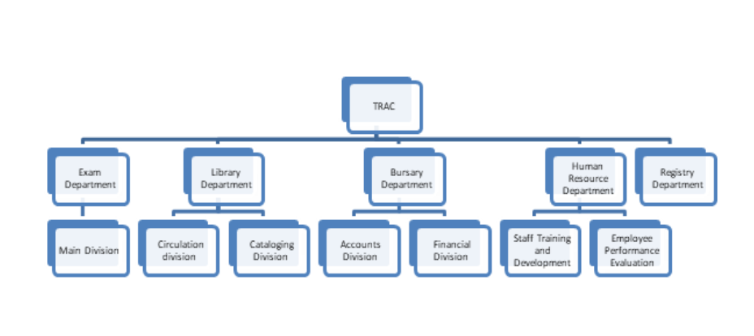
Organisation Structure

Slide 8
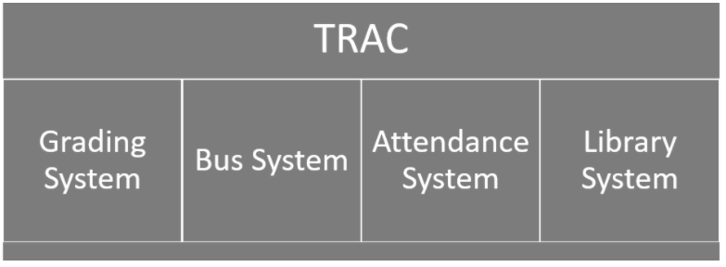
Current System Used

Slide 9
02
System Planning
-System Request

Slide 10
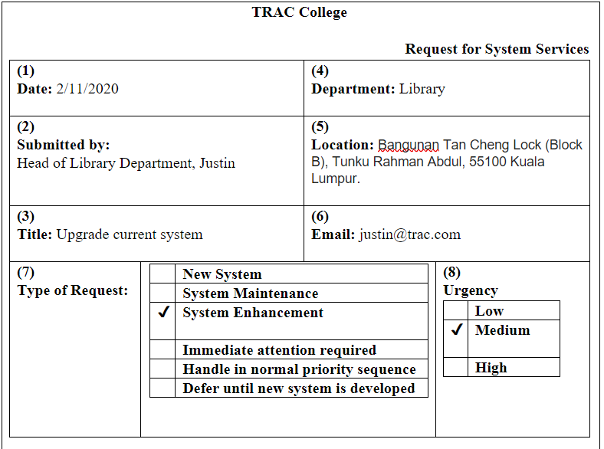
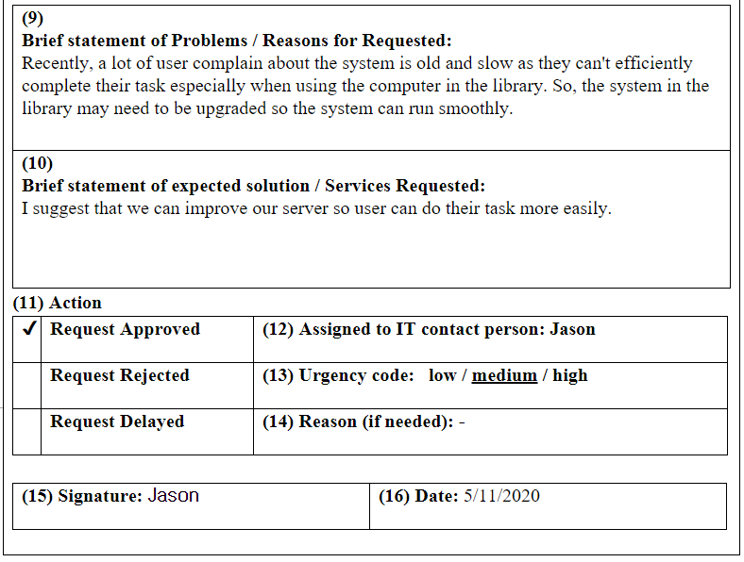
System Request Form

Slide 11
Reason of Request
Insufficient information
of user needs
Weak internet connection
Slow Responses
System may not be able to support in long-term and this will affect the overall performance of the library system.
The system might produce small amount, incomplete or even wrong information to the user.
The internet connection which connected to the system may not be enough to support the server.

Slide 12
Services Requested
Improved Performance
Information Improvements
Weak internet connection
This result in a faster and better system performance that users are no longer needed to wait for the service process.
It makes the system to have a better understanding of the user’s favorite's books.
To improve the efficiency of the system, a faster and smoother internet connection is needed.

Slide 13
03
System Planning
-Feasibility Study

Slide 14
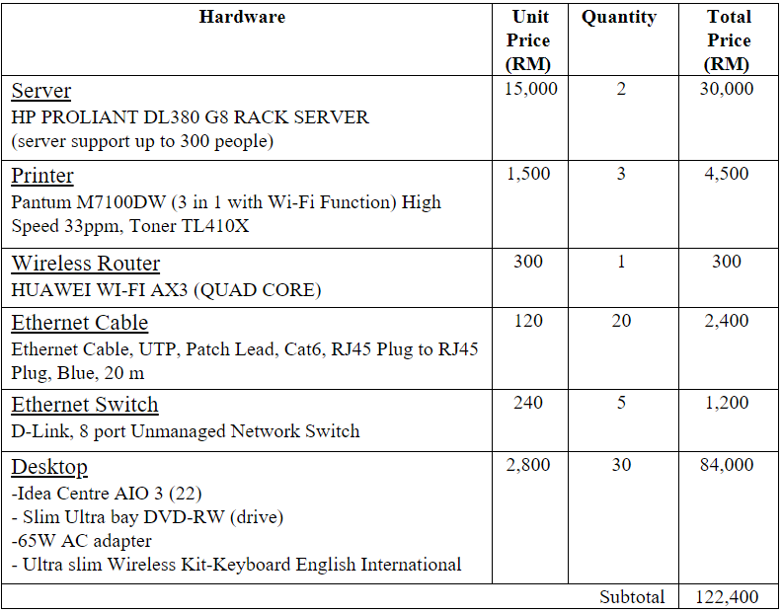
Hardware Cost

Slide 15
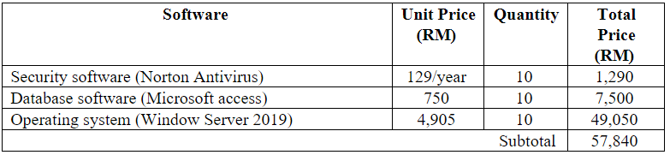
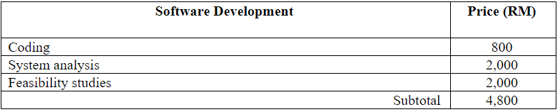
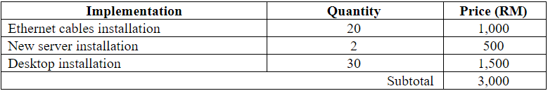
Software Cost
Software Development Cost
Implementation Cost

Slide 16
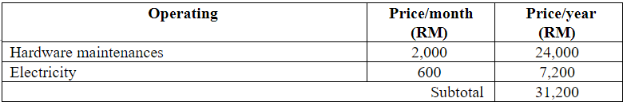
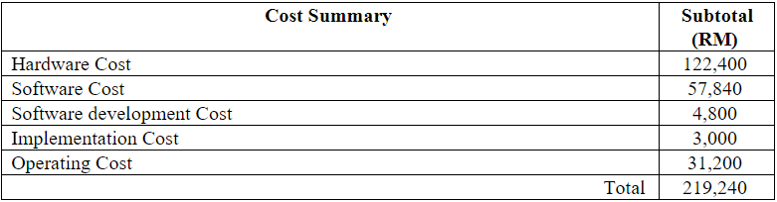
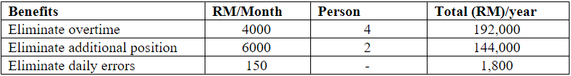
Operating Cost
Cost Summary
Benefit Summary

Slide 17
Intangible Benefits
Enhanced User Experience
Stronger System Security
Faster Response Time
The new servers and routers will make the system more capable of carrying a large number of users to browse at the same time.
Developers can greatly improve the security of their system.
The entire system can handle more requests at the same time than before.

Slide 18
04
System Analysis
-Context Diagram
-Diagram 0 DFD
-Diagram 1 DFD

Slide 19
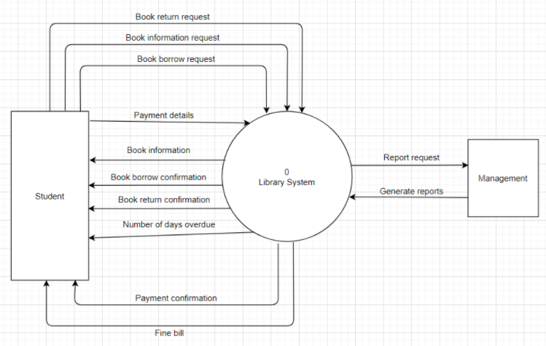
Context Diagram

Slide 20
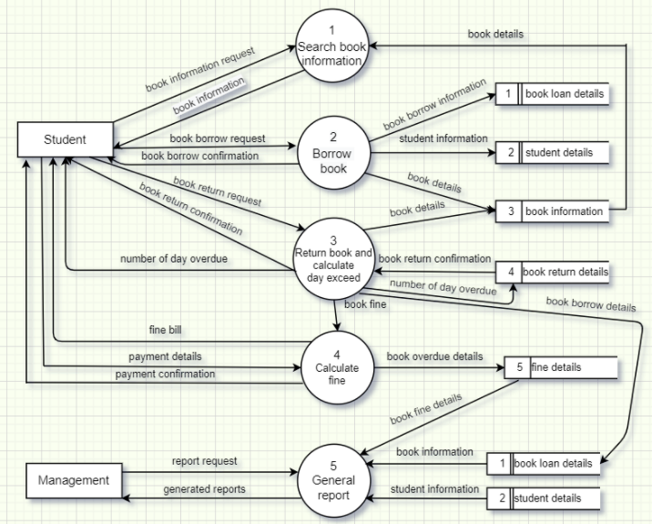
Diagram 0 DFD

Slide 21
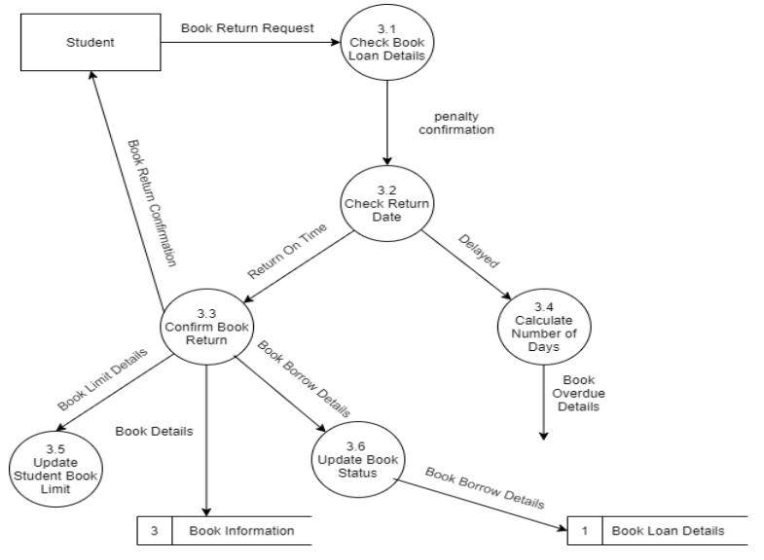
Diagram 1 DFD

Slide 22
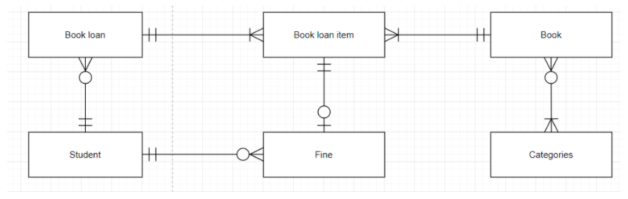
ERD Diagram

Slide 23
05
System Design
-Data Input Screen
-Complete ERD diagram with attributes and keys

Slide 24
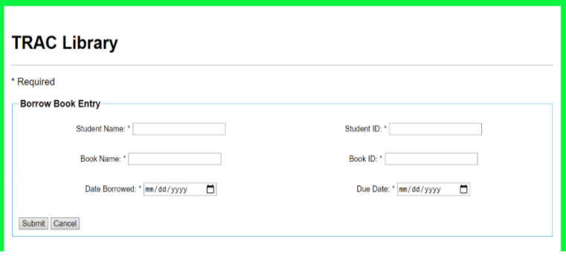
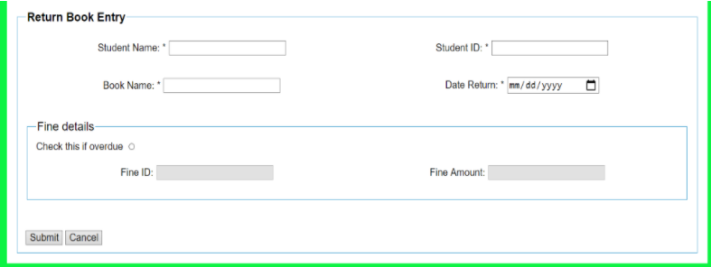
Data Input Screen

Slide 25
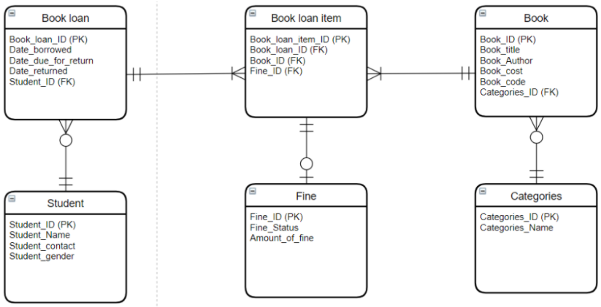
Complete ERD Diagram

Slide 26
06
System Design
-Code Design
-Reports

Slide 27
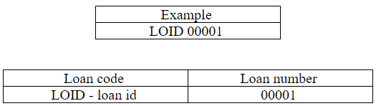
Book_Loan_ID
This is the code design for the primary key (Book_loan_ID) in Book loan entity.
01
02
Significant alphabetic code (LOID) means loan id.
Sequence code (00001) means the serial No. of loan.
03

Slide 28
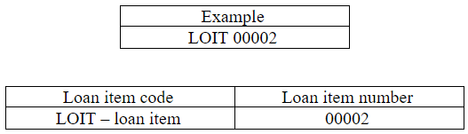
Book_Loan_Item_ID
This is the code design for the primary key (Book_loan_item_ID) in Book loan item entity.
01
02
Significant alphabetic code (LOIT) means loan item.
Sequence code (00002) means the serial No. of loan item.
03

Slide 29
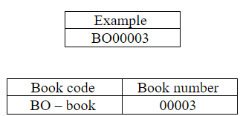
Book_ID
This is the code design for the primary key (Book_ID) in book entity.
01
02
Significant alphabetic code (BO) means book.
Sequence code (00003) means the serial No. of book.
03

Slide 30
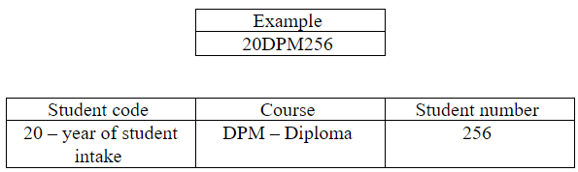
Student_ID
This is the code design for the primary key (Student_ID) in student entity.
01
02
Derivation code (20) means year 2020 of the student intake, (21) means year 2021.
For code (DPM) means diploma course is took by the student, it can also change as (DG) for degree or (MT) for master course.
03
For code (256) means number 256th students in this course.
04

Slide 31
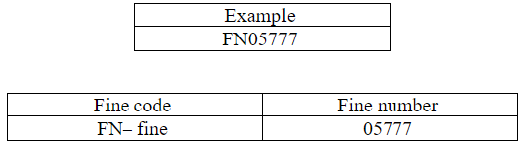
Fine_ID
This is the code design for the primary key (Fine_ID) in fine entity.
01
02
Significant alphabetic code (FN) means fine.
Significant digit code (05777) 05 means the month of getting fine and 777 means 777th student.
03

Slide 32
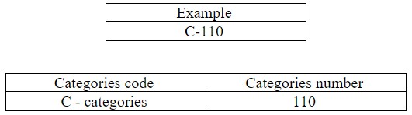
Categories_ID
This is the code design for the primary key (Categories_ ID) in categories entity.
01
02
Significant alphabetic code (C) can be replaced by other alphabet. For example, (H) is Horror, (F) is Fantasy, (A) is Adventure and etc.
For sequence code (110) means the sequence of categories.
03

Slide 33
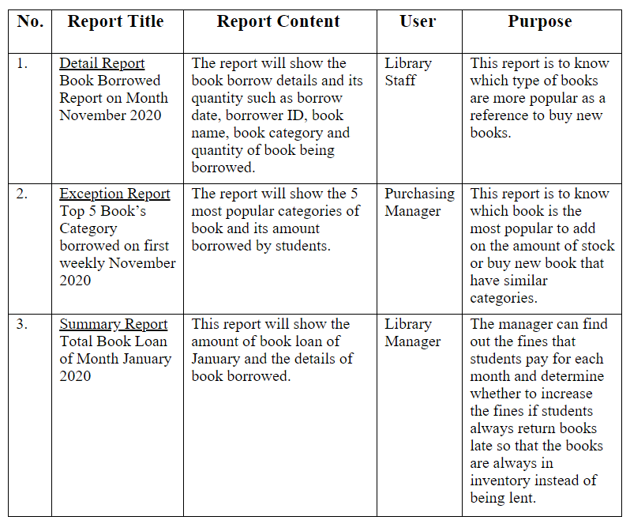
Table of Reports

Slide 34
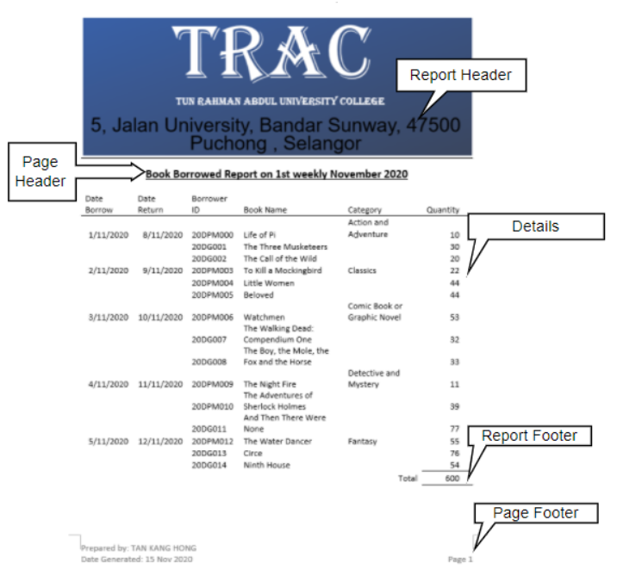
Detail Report

Slide 35
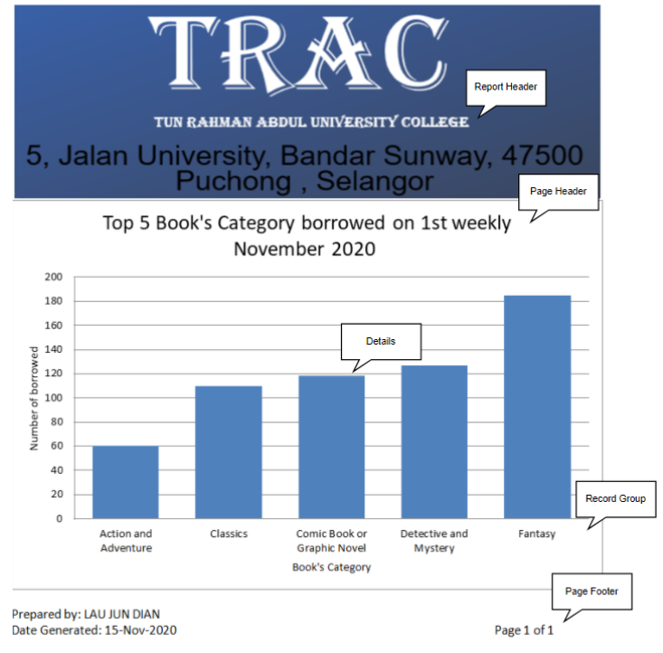
Exception Report

Slide 36
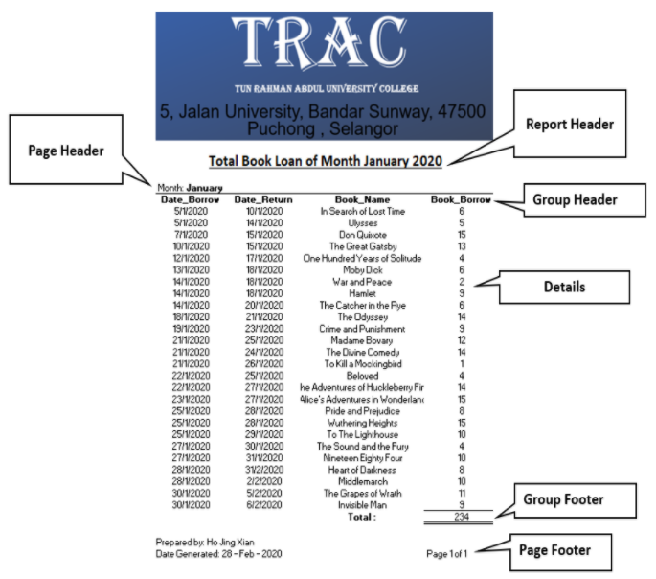
Summary Report

Slide 37
Priciple of Good Report Design
Useful Content of the Report
This making the readers easy to understand when viewing the report.
Simple Layout of Report
The layout design of report is suitable and not too complicated for the managers to read.
Meaningful report titles
To further make the report better and clearer, the report title is specially considered that the report title will not be too long for the readers to focus on what the report shown.
Useful Headers of Report
As long as the managers quote the required category at any time, they can find the information they need without wasting any time.

Slide 38
END
THANK YOU

